Slide 1
Biochem-726 2(2-0) GENE REGULATION AND EXPRESSION
Introduction to gene expression. Bacterial gene control: Operons; The mal regulon, ara operon, trp operon. Control of transcription during bacterial sporulation. Genes with multiple promoters. Heterologous and homologous expression of genes in E. coli and yeast. Effect of promoters on gene expression. Protein-DNA interactions for the control of transcription. Transcription factors in eukaryotes: types, structures and functions for RNA polymerase I, II and III. Signal-mediated transport of mRNA through nuclear pore complexes. Transcription activators in eukaryotic transcription. Role of transcription termination in pol.II gene regulation. Protein modifications for gene expression: Histone acetylation, Sumoylation etc. Gene regulation and splicing. Gene silencing. qPCR and microarray for the study of gene expression. Catabolite repression of genes in fungi. Gene regulation and expression in archaebacteria. Bioinformatics tools for the study of gene expression and regulation.

Slide 2
SUGGESTED READINGS
Lesk, A. M. 2002. Introduction to bioinformatics. Oxford Univ. Press, U.K.
Lodish, H., A. Berk, C. A.Kaiser, M. Krieger, M. P. Scott, A. Bretscher, H. Ploegh and P. Matsudaira, P. 2008. Molecular Cell Biology. 6th Ed. Freeman W. H. USA.
Nelson, D.L and M.M. Cox. 2008. Lehninger Principles of Biochemistry. 5th edition, Worth Publishers, New York
Sambrook, J. and D. W. Russell. 2000. Molecular cloning, a laboratory manual. Cold Spring Harbor Laboratory Press, N. Y.
Talbot, N. 2001. Molecular and Cellular Biology of Filamentous Fungi. Oxford university press
Wagner, R. 2000. Transcription Regulation in Prokaryotes. Oxford university press
Watson, J. D., Baker, T. A., Bell, S. P., Gann, A., Levine, M. and Losick, R. 2007. Molecular Biology of the Gene. 5th Ed. Pearson/Benjamin Cummings, CA.
Weaver, R. F. 2008. Molecular Biology. 4th edition. McGraw Hill, USA.

Slide 3
Gene Expression
Prokaryotic gene expression
Lac operon
Trp operon
Eukaryotic gene expression
Heterologous gene expression

Slide 4
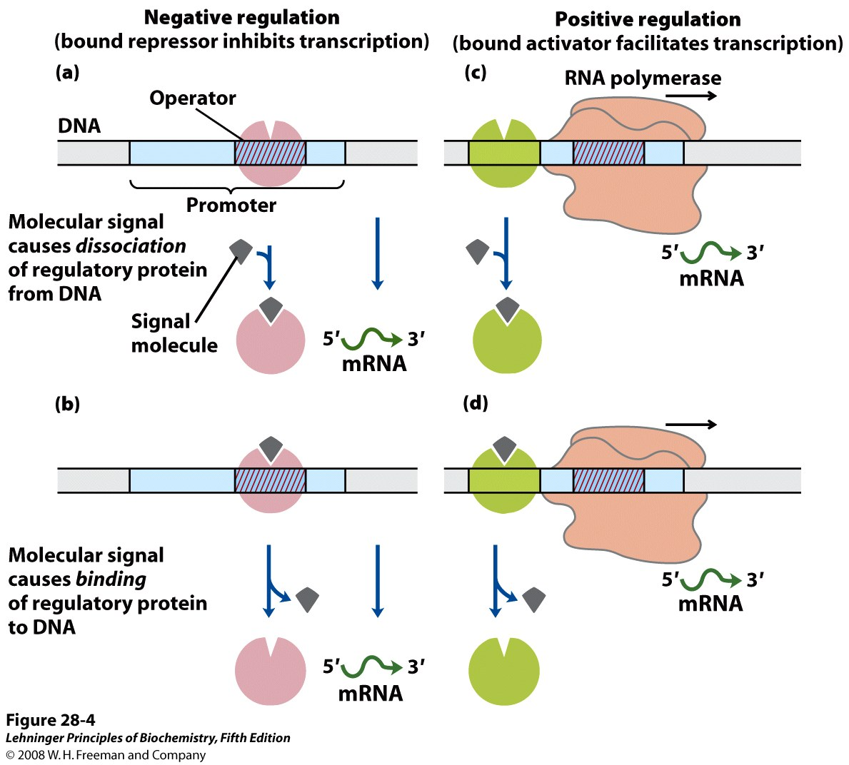
Notes:
FIGURE 28-4 Common patterns of regulation of transcription initiation. Two types of negative regulation are illustrated. (a) Repressor (pink) binds to the operator in the absence of the molecular signal; the external signal causes dissociation of the repressor to permit transcription. (b) Repressor binds in the presence of the signal; the repressor dissociates and transcription ensues when the signal is removed. Positive regulation is mediated by gene activators. Again, two types are shown. (c) Activator (green) binds in the absence of the molecular signal and transcription proceeds; when the signal is added, the activator dissociates and transcription is inhibited. (d) Activator binds in the presence of the signal; it dissociates only when the signal is removed. Note that "positive" and "negative" regulation refer to the type of regulatory protein involved: the bound protein either facilitates or inhibits transcription. In either case, addition of the molecular signal may increase or decrease transcription, depending on its effect on the regulatory protein.

Slide 5
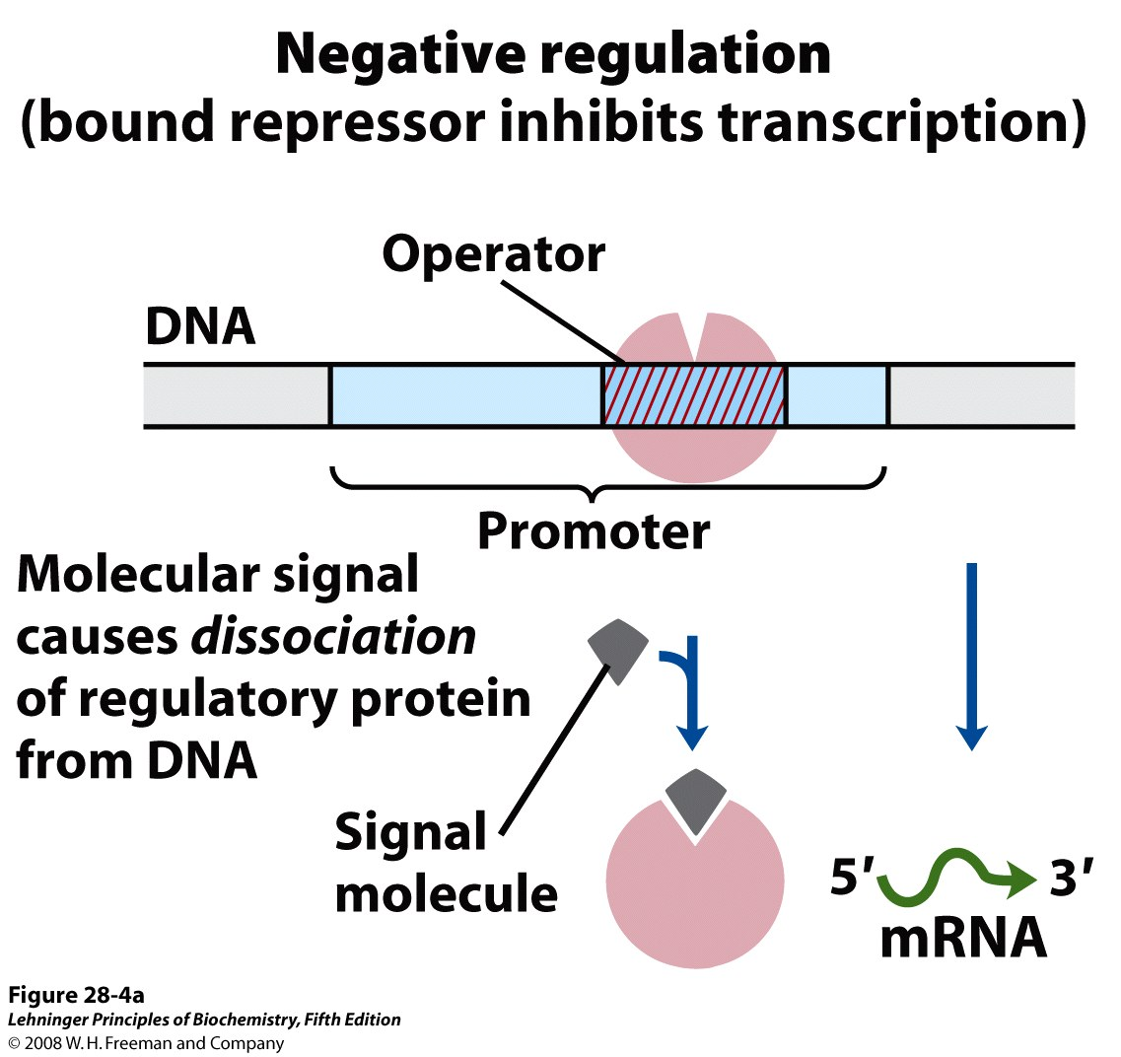
Notes:
FIGURE 28-4a Common patterns of regulation of transcription initiation. Two types of negative regulation are illustrated. (a) Repressor (pink) binds to the operator in the absence of the molecular signal; the external signal causes dissociation of the repressor to permit transcription.

Slide 6
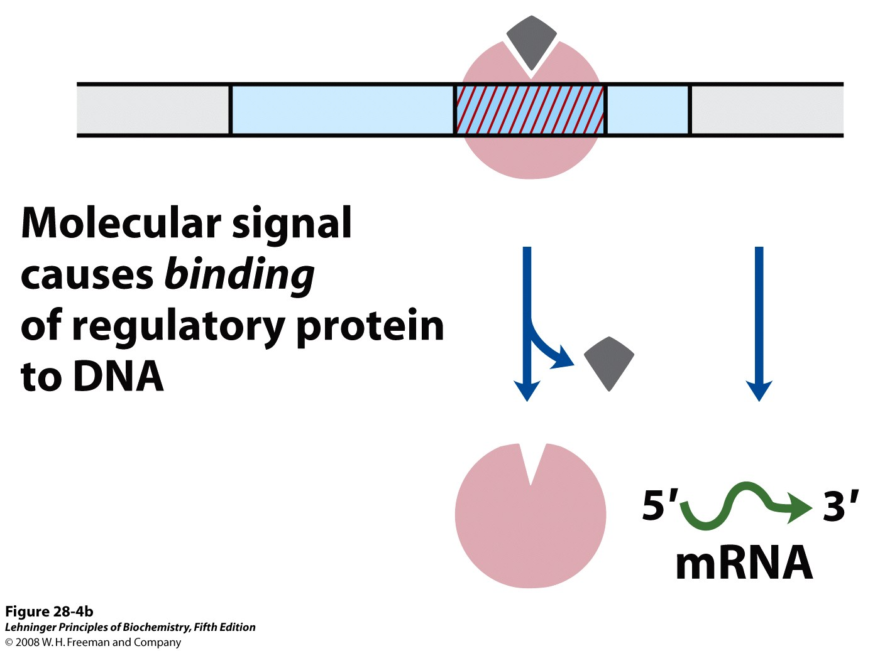
Notes:
FIGURE 28-4b Common patterns of regulation of transcription initiation. Two types of negative regulation are illustrated. (b) Repressor binds in the presence of the signal; the repressor dissociates and transcription ensues when the signal is removed. Positive regulation is mediated by gene activators. Again, two types are shown.

Slide 7
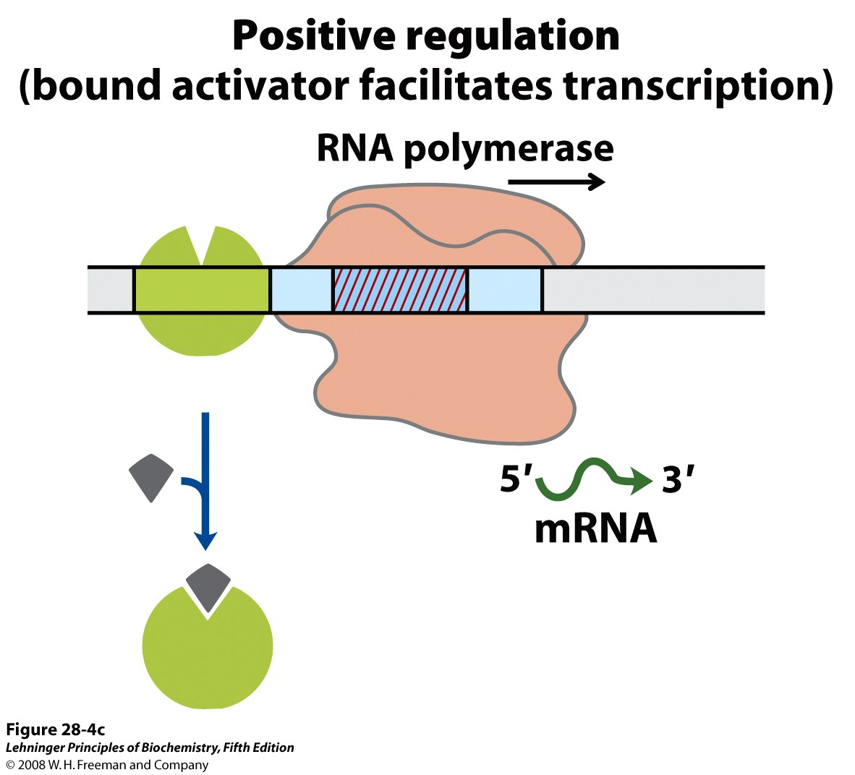
Notes:
FIGURE 28-4c Common patterns of regulation of transcription initiation. Two types of negative regulation are illustrated. (c) Activator (green) binds in the absence of the molecular signal and transcription proceeds; when the signal is added, the activator dissociates and transcription is inhibited.

Slide 8
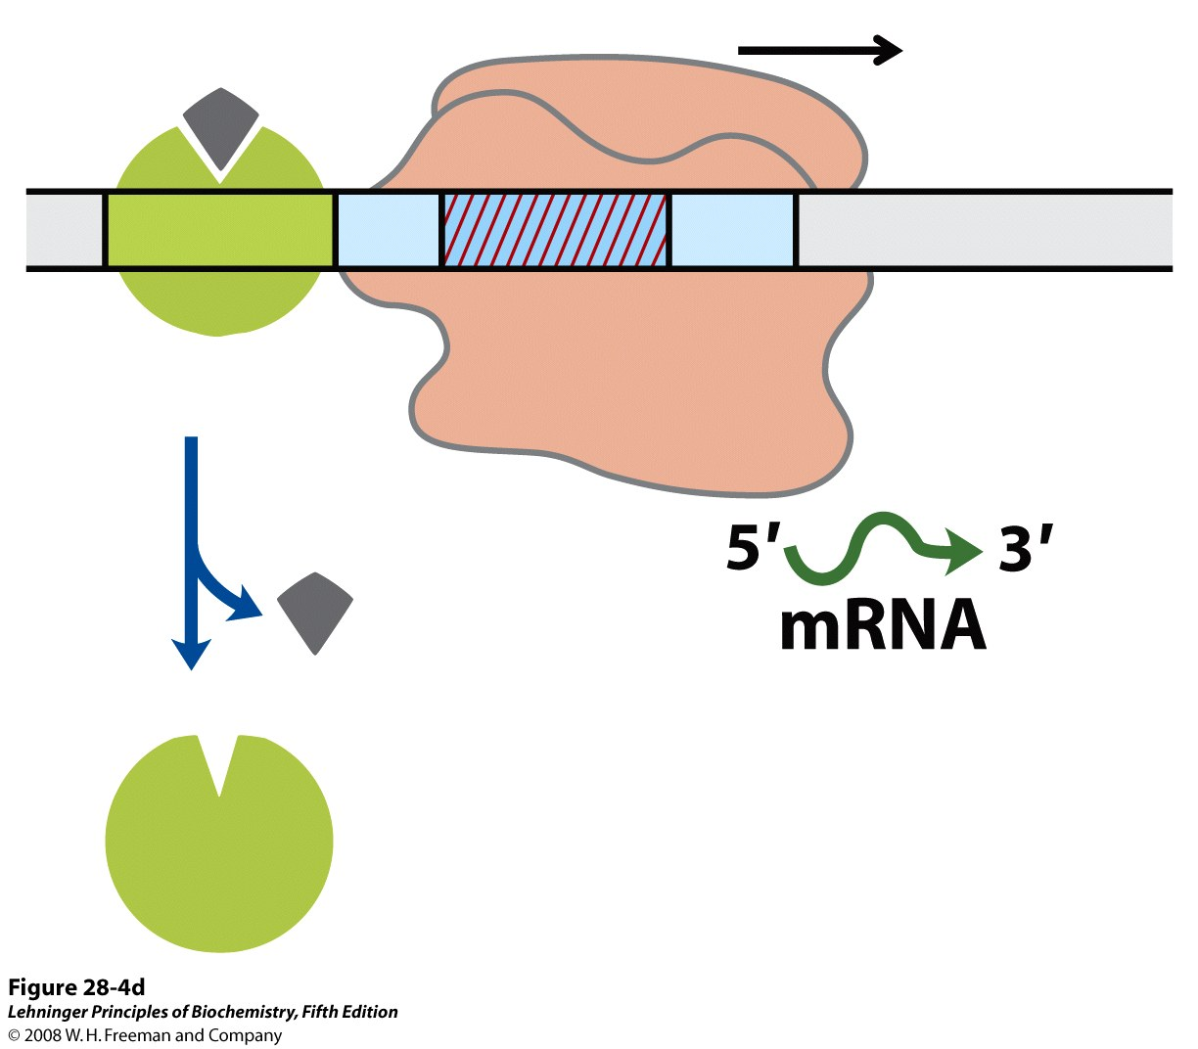
Notes:
FIGURE 28-4d Common patterns of regulation of transcription initiation. Two types of negative regulation are illustrated. (d) Activator binds in the presence of the signal; it dissociates only when the signal is removed. Note that "positive" and "negative" regulation refer to the type of regulatory protein involved: the bound protein either facilitates or inhibits transcription. In either case, addition of the molecular signal may increase or decrease transcription, depending on its effect on the regulatory protein.

Slide 9
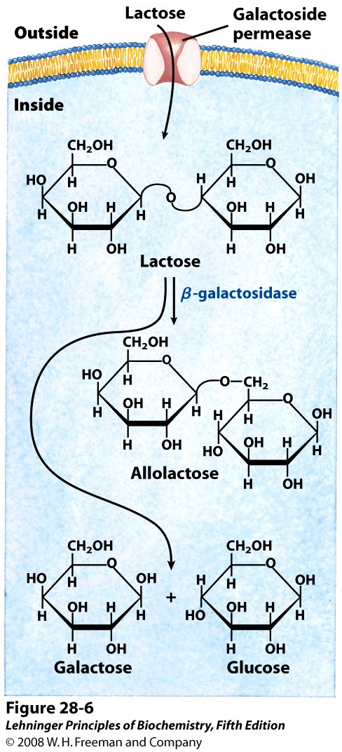
Notes:
FIGURE 28-6 Lactose metabolism in E. coli. Uptake and metabolism of lactose require the activities of galactoside (lactose) permease and β-galactosidase. Conversion of lactose to allolactose by transglycosylation is a minor reaction also catalyzed by β-galactosidase.

Slide 10
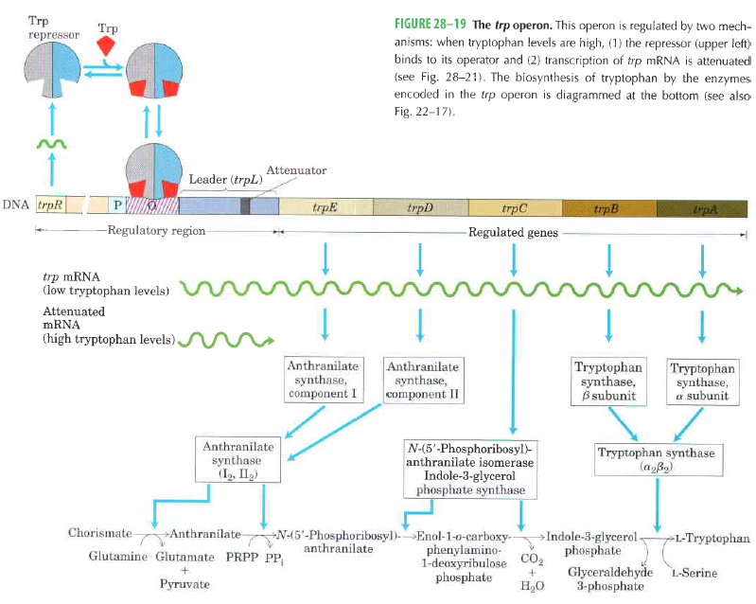

Slide 11
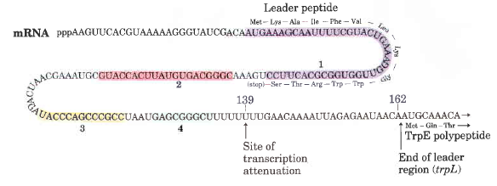

Slide 12
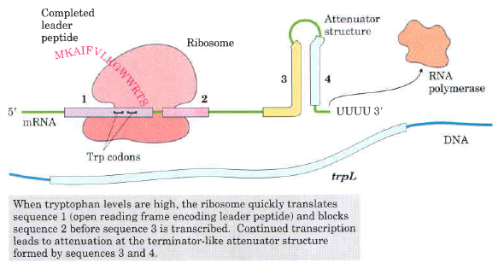
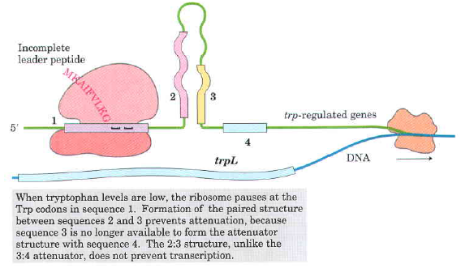

Slide 13
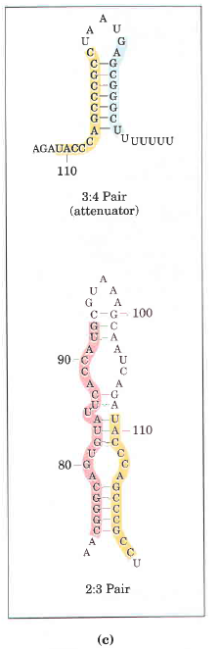

Slide 14
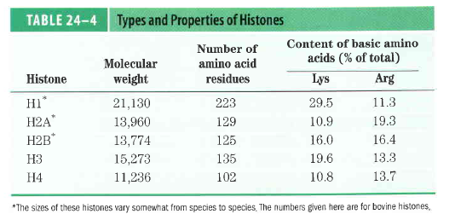

Slide 15
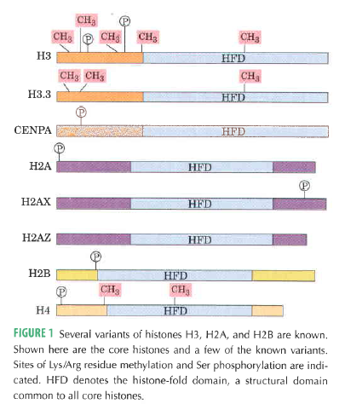

Slide 16
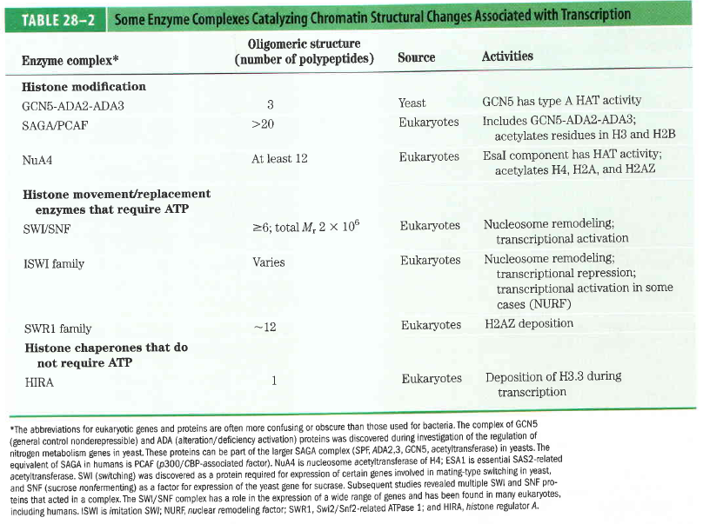

Slide 20
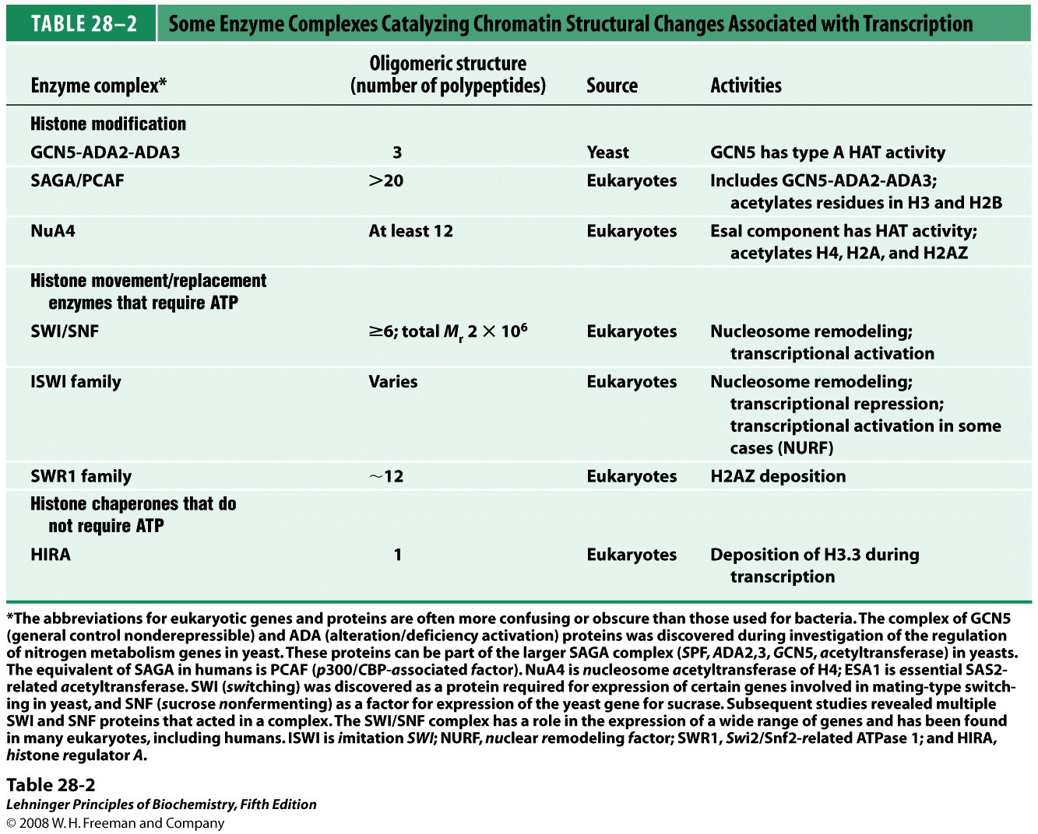
Notes:
TABLE 28-2 Some Enzyme Complexes Catalyzing Chromatin Structural Changes Associated with Transcription

Slide 21
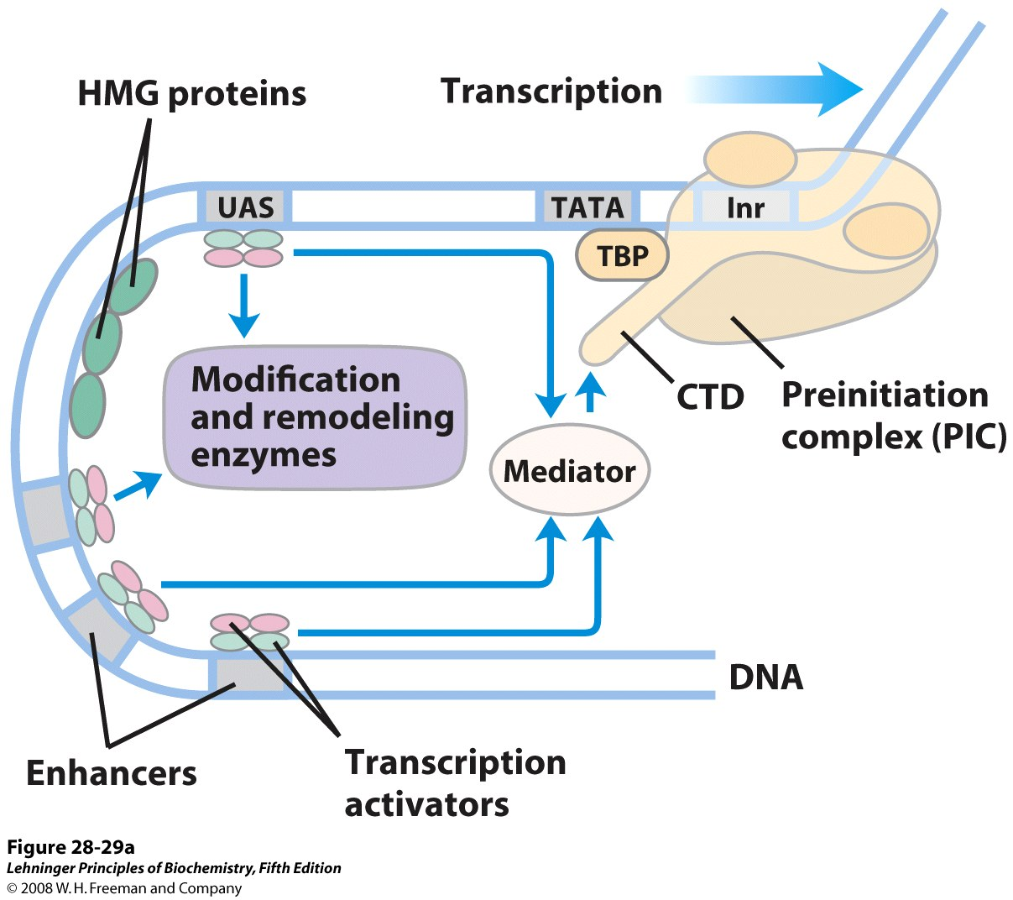
Notes:
FIGURE 28-29a Eukaryotic promoters and regulatory proteins. RNA polymerase II and its associated basal (general) transcription factors form a preinitiation complex at the TATA box and Inr site of the cognate promoters, a process facilitated by transcription activators, acting through mediator. (a) A composite promoter with typical sequence elements and protein complexes found in both yeast and higher eukaryotes. The carboxyl-terminal domain (CTD) of Pol II (see Figure 26-10) is an important point of interaction with mediator and other protein complexes. The histone modification enzymes catalyze methylation and acetylation; the remodeling enzymes alter the content and placement of nucleosomes. For the transcription activators, DNA-binding domains are shown in green, activation domains in pink. The interactions symbolized by blue arrows are discussed in the text.

Slide 22
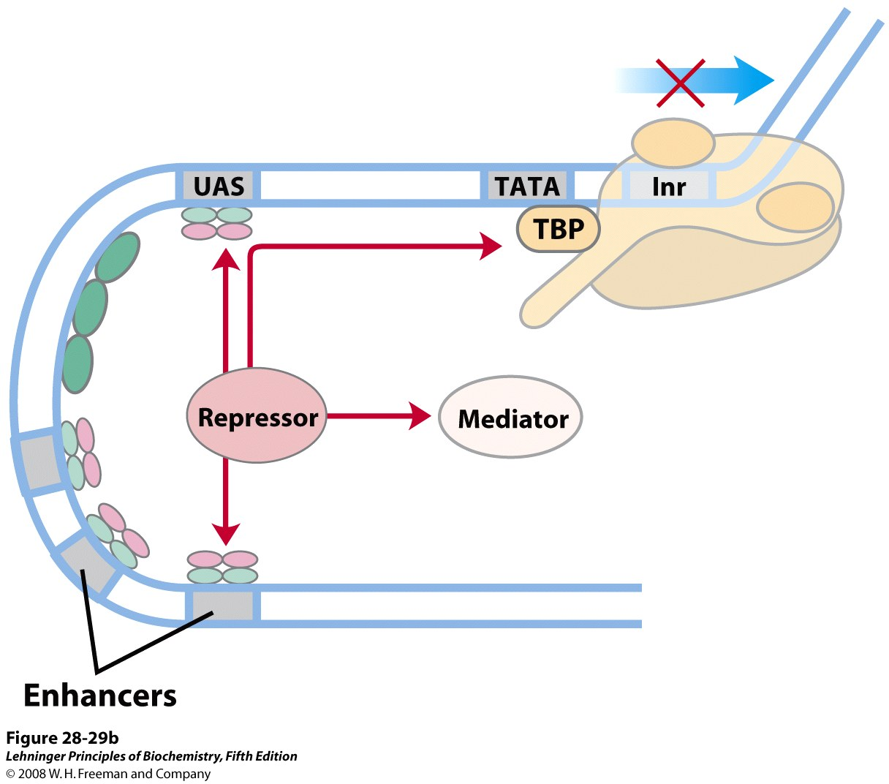
Notes:
FIGURE 28-29b Eukaryotic promoters and regulatory proteins. RNA polymerase II and its associated basal (general) transcription factors form a preinitiation complex at the TATA box and Inr site of the cognate promoters, a process facilitated by transcription activators, acting through mediator. (b) Eukaryotic transcriptional repressors function by a range of mechanisms. Some bind directly to DNA, displacing a protein complex required for activation; others interact with various parts of the transcription or activation complexes to prevent activation. Possible points of interaction are indicated with red arrows.

Slide 23
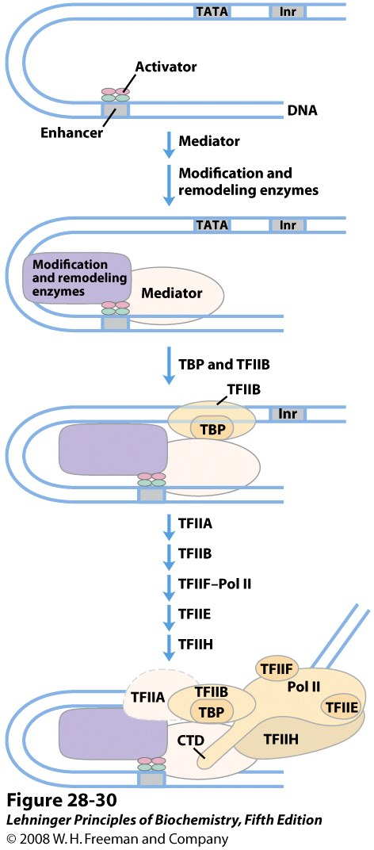
Notes:
FIGURE 28-30 The components of transcriptional activation. Activators may bind the DNA first. The activators recruit the histone modification/ nucleosome remodeling complexes and mediator. Mediator facilitates the binding of TBP and TFIIB, and the other basal transcription factors and Pol II then bind. Phosphorylation of the carboxyl-terminal domain (CTD) of Pol II leads to transcription initiation (not shown).

Slide 24
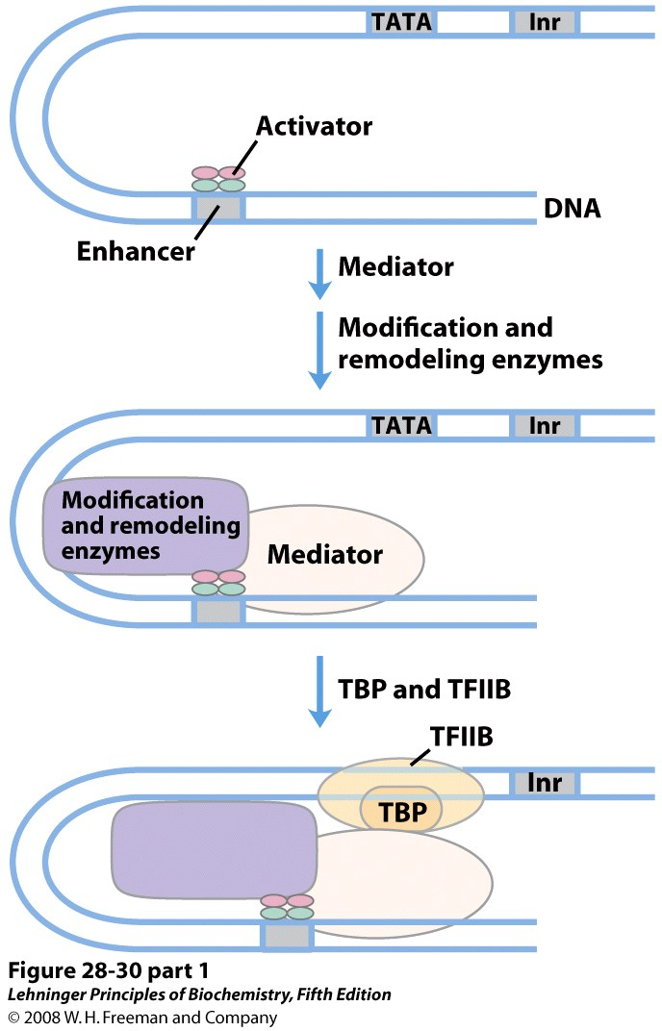
Notes:
FIGURE 28-30 (part 1) The components of transcriptional activation. Activators may bind the DNA first. The activators recruit the histone modification/ nucleosome remodeling complexes and mediator. Mediator facilitates the binding of TBP and TFIIB, and the other basal transcription factors and Pol II then bind. Phosphorylation of the carboxyl-terminal domain (CTD) of Pol II leads to transcription initiation (not shown).

Slide 25
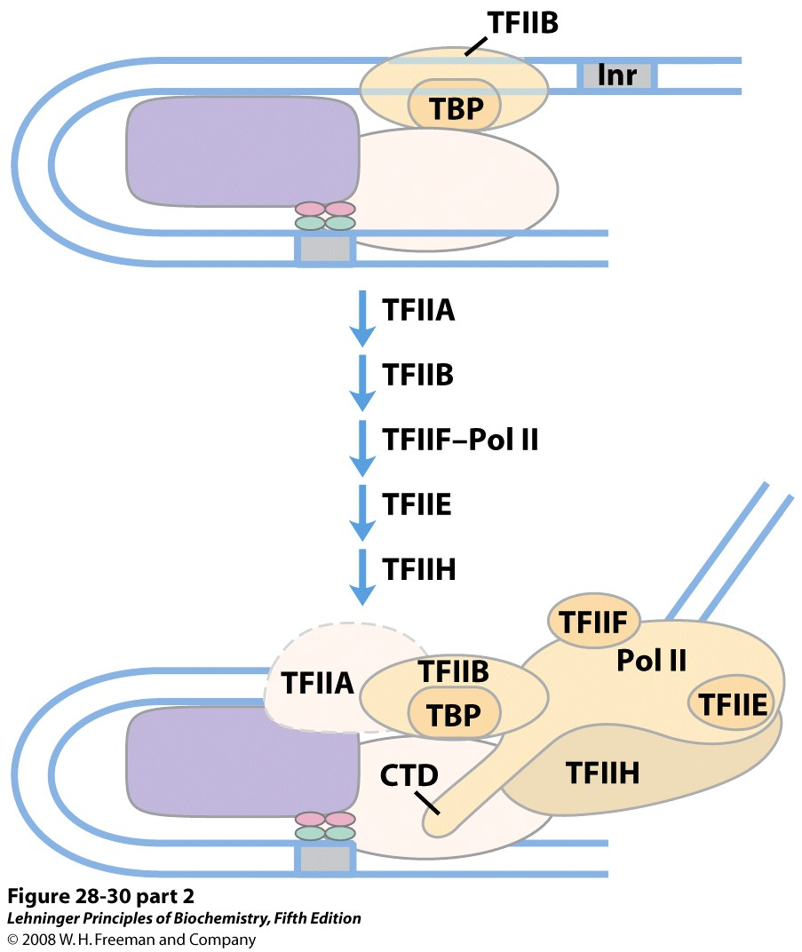
Notes:
FIGURE 28-30 (part 2) The components of transcriptional activation. Activators may bind the DNA first. The activators recruit the histone modification/ nucleosome remodeling complexes and mediator. Mediator facilitates the binding of TBP and TFIIB, and the other basal transcription factors and Pol II then bind. Phosphorylation of the carboxyl-terminal domain (CTD) of Pol II leads to transcription initiation (not shown).

Slide 26
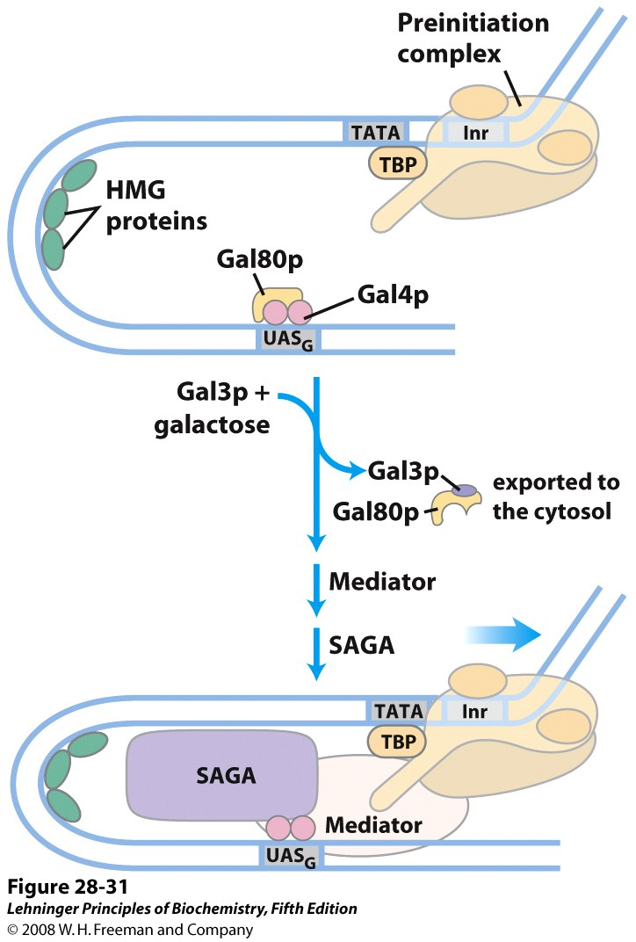
Notes:
FIGURE 28-31 Regulation of transcription of GAL genes in yeast. Galactose imported into the yeast cell is converted to galactose 6-phosphate by a pathway involving six enzymes, whose genes are scattered over three chromosomes (see Table 28-3). Transcription of these genes is regulated by the combined actions of the proteins Gal4p, Gal80p, and Gal3p, with Gal4p playing the central role of transcription activator. The Gal4p-Gal80p complex is inactive. Binding of galactose to Gal3p and interaction of Gal3p with Gal80p produces a conformational change in Gal80p. The Gal3p-Gal80p complex is then exported from the nucleus, allowing Gal4p to recruit mediator and SAGA and function in transcriptional activation.

Slide 27
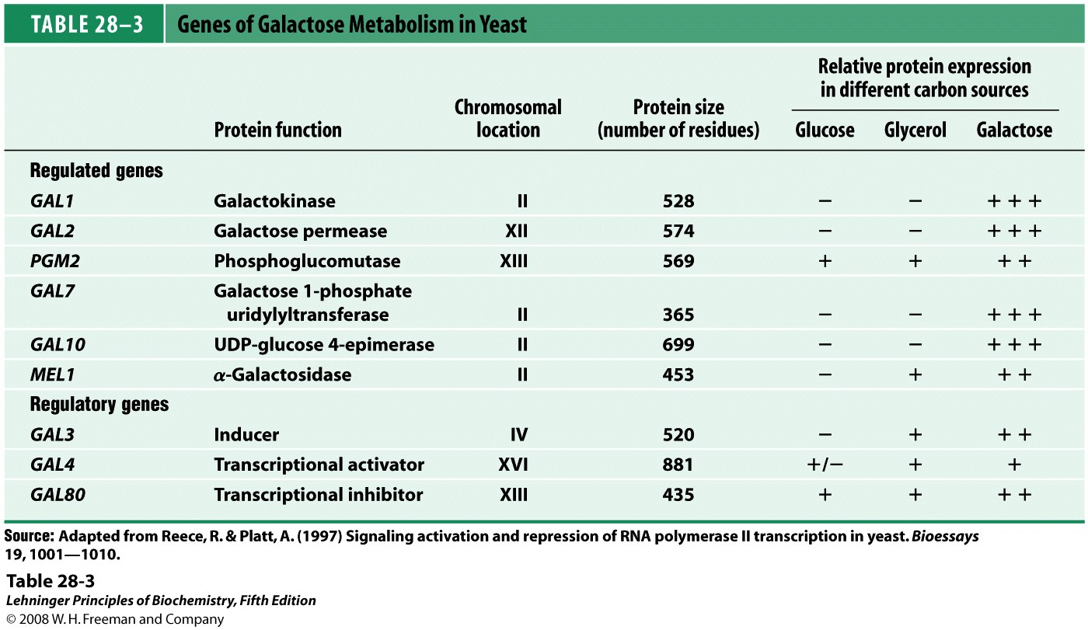
Notes:
TABLE 28-3 Genes of Galactose Metabolism in Yeast

Slide 28
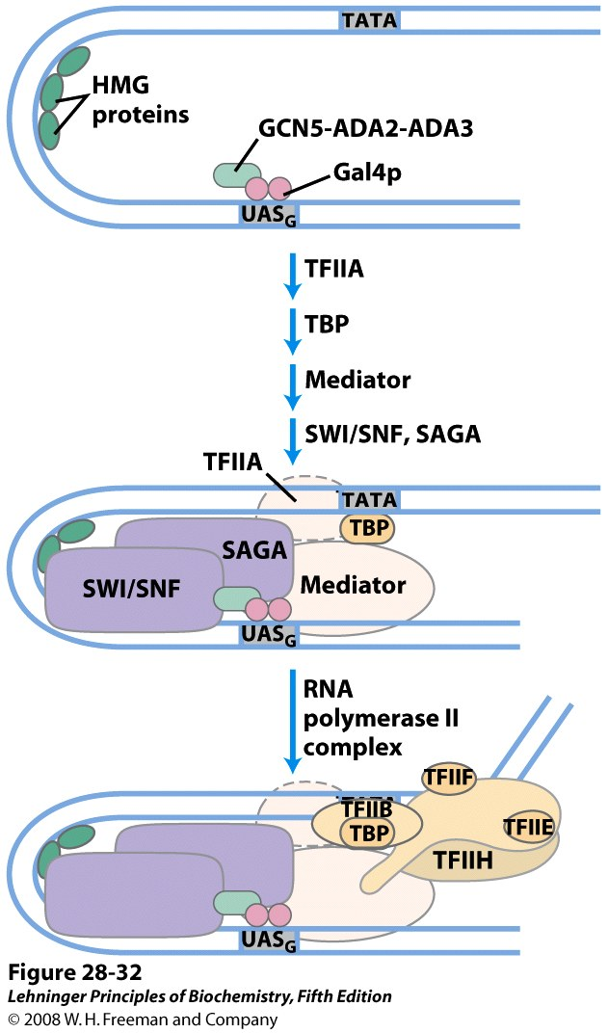
Notes:
FIGURE 28-32 Protein complexes involved in transcriptional activation of a group of related eukaryotic genes. The GAL system illustrates the complexity of this process, but not all these protein complexes are yet known to affect GAL gene transcription. Note that many of the complexes (such as SWI/SNF, GCN5-ADA2-ADA3, and mediator) affect the transcription of many genes. The complexes assemble stepwise, as shown in Figure 28-30.

Slide 29
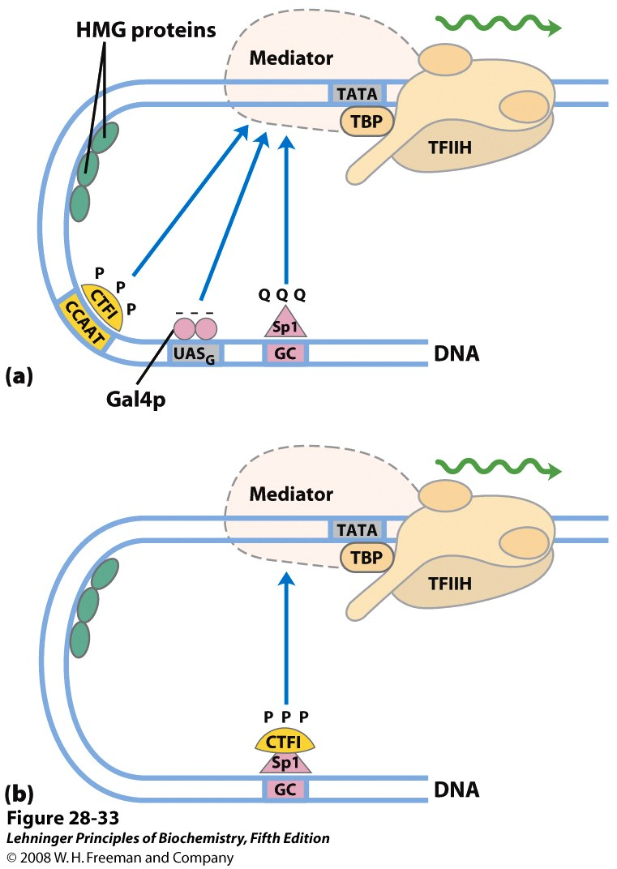
Notes:
FIGURE 28-33 Transcription activators. (a) Typical activators such as CTF1, Gal4p, and Sp1 have a DNA-binding domain and an activation domain. The nature of the activation domain is indicated by symbols: – – –, acidic; Q Q Q, glutamine-rich; P P P, proline-rich. These proteins generally activate transcription by interacting with coactivator complexes such as mediator. Note that the binding sites illustrated here are not generally found together near a single gene. (b) A chimeric protein containing the DNA-binding domain of Sp1 and the activation domain of CTF1 activates transcription if a GC box is present.

Slide 30
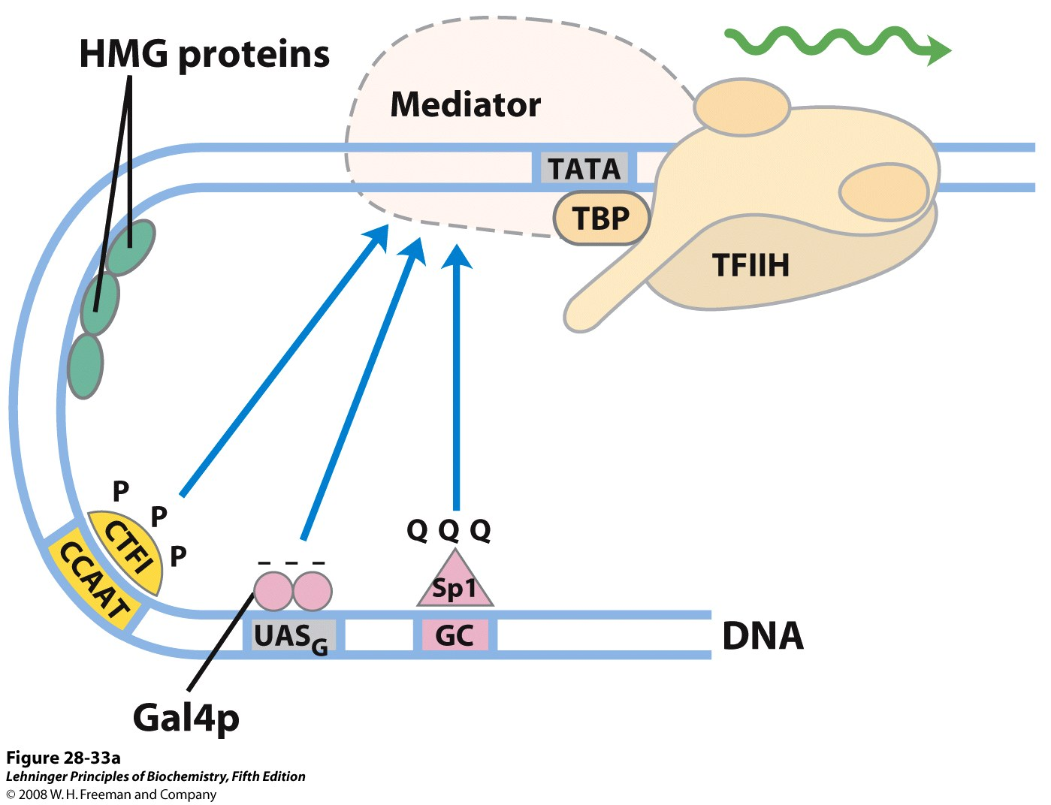
Notes:
FIGURE 28-33a Transcription activators. (a) Typical activators such as CTF1, Gal4p, and Sp1 have a DNA-binding domain and an activation domain. The nature of the activation domain is indicated by symbols: – – –, acidic; Q Q Q, glutamine-rich; P P P, proline-rich. These proteins generally activate transcription by interacting with coactivator complexes such as mediator. Note that the binding sites illustrated here are not generally found together near a single gene.

Slide 31
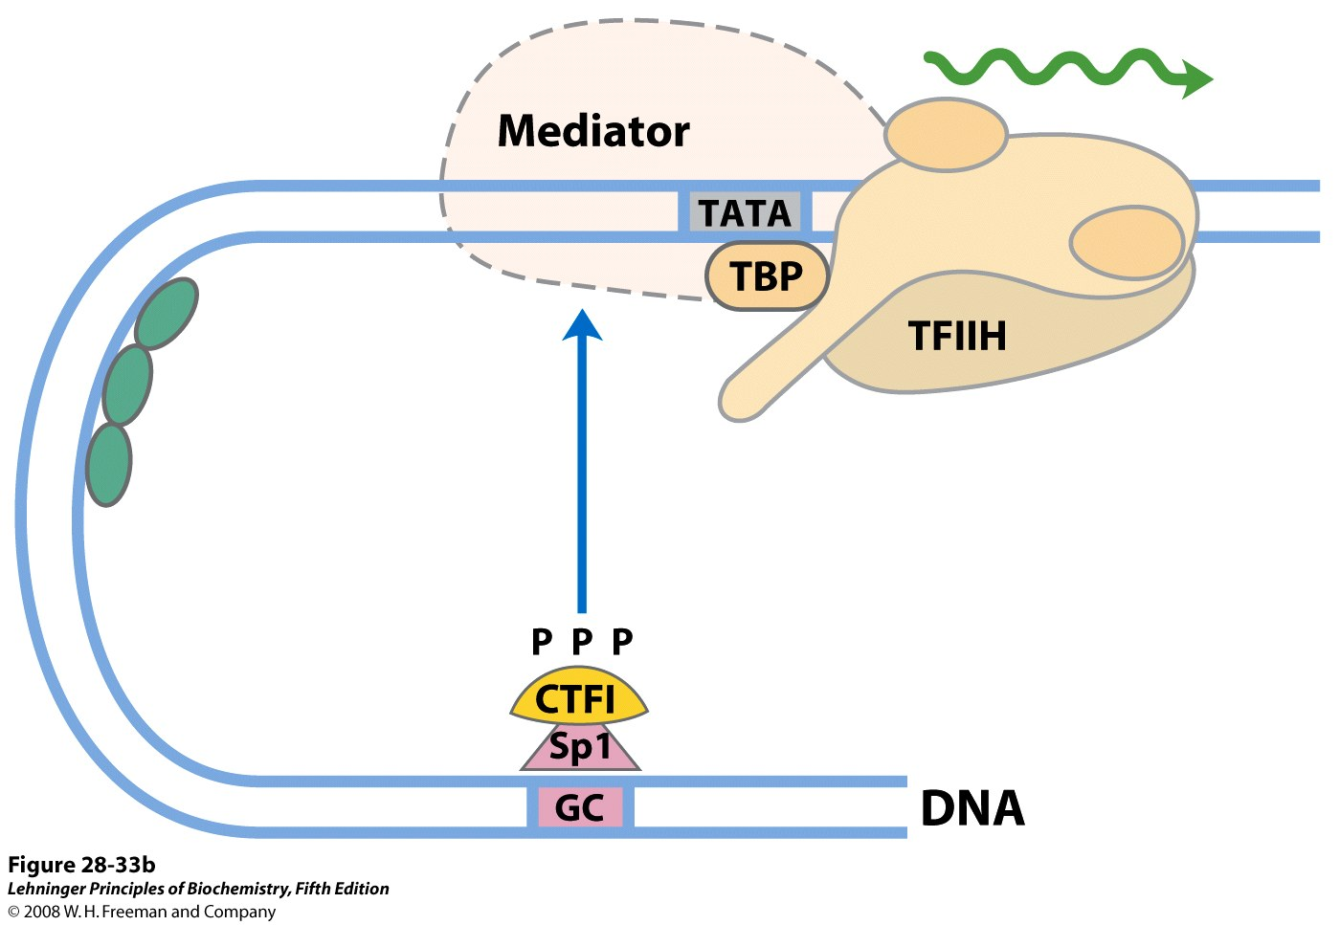
Notes:
FIGURE 28-33b Transcription activators. (b) A chimeric protein containing the DNA-binding domain of Sp1 and the activation domain of CTF1 activates transcription if a GC box is present.

Slide 32
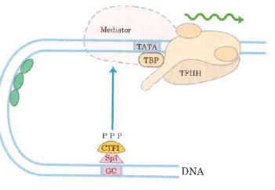
Domain Swapping
Join Pro-rich domain of CTF1 to DNA-binding domain of Sp1
Another example:
Replace DNA-binding domain of Gal4p with DNA-binding domain of E. coli LexA repressor – No binding at UAS neither activation of GAL genes
Activation of the genes may take place when UAS sequence is replaced by a LexA recognition site

Slide 33
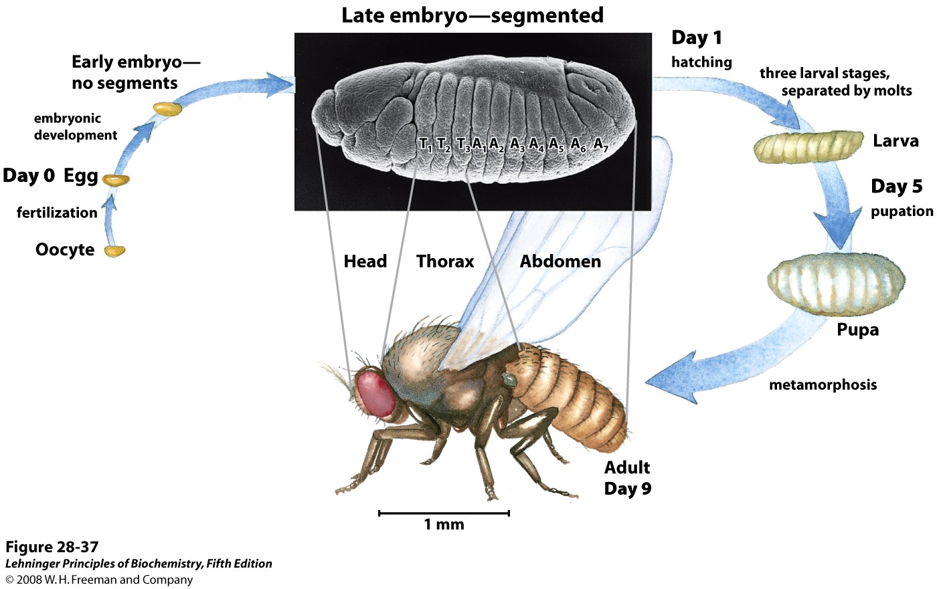
Notes:
FIGURE 28-37 Life cycle of the fruit fly Drosophila melanogaster. Drosophila undergoes a complete metamorphosis, which means that the adult insect is radically different in form from its immature stages, a transformation that requires extensive alterations during development. By the late embryonic stage, segments have formed, each containing specialized structures from which the various appendages and other features of the adult fly will develop.

Slide 34
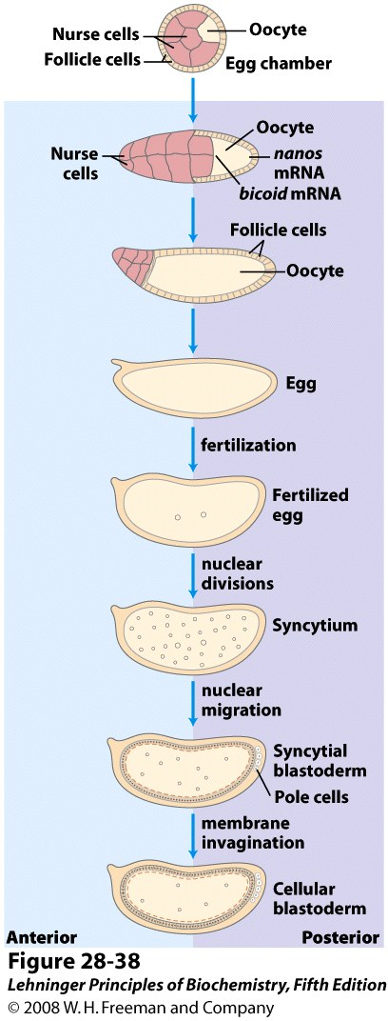
Notes:
FIGURE 28-38 Early development in Drosophila. During development of the egg, maternal mRNAs (including the bicoid and nanos gene transcripts, discussed in the text) and proteins are deposited in the developing oocyte (unfertilized egg cell) by nurse cells and follicle cells. After fertilization, the two nuclei of the fertilized egg divide in synchrony within the common cytoplasm (syncytium), then migrate to the periphery. Membrane invaginations surround the nuclei to create a monolayer of cells at the periphery; this is the cellular blastoderm stage. During the early nuclear divisions, several nuclei at the far posterior become pole cells, which later become the germ-line cells.

Slide 35
Regulatory proteins
10⁴ to 10⁶ times higher affinity
Discrete DNA binding domains
Include one or more of a relatively small group of recognizable and characteristic structural motif
Amino acid side chains often hydrogen-bonding to the DNA basis with Asn, Gln, Glu, Lys, Arg residues
However, no simple amino acid-base code

Slide 36
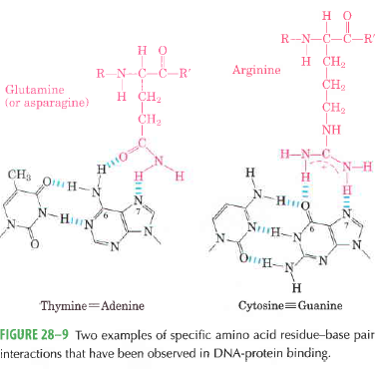

Slide 37
DNA binding domains of regulatory proteins tend to be small (60-90 aa residues)
Structural motifs within these domains are smaller still……
The DNA binding sites for regulatory proteins are often inverted repeats of a short DNA sequence (palinderome)----- at which multiple (usually two) subunits of a regulatory protein bind cooperatively.
Lac repressor however functions as a tetramer

Slide 38
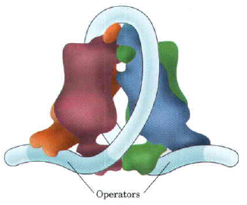
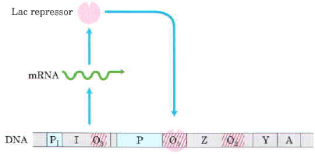

Slide 39
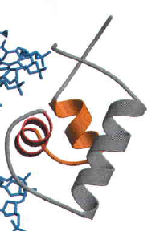
DNA binding motifs
There are several; two are:
Helix-turn-helix
20 aa in two short α-helical segments each 7-9 aa residues long separated by a β-turn

Slide 40
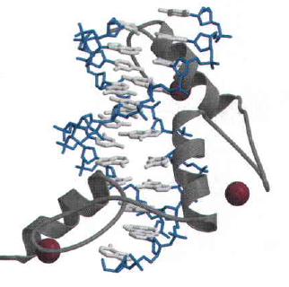
Zinc finger
~30 aa residues form an elongated loop held together by a single Zn²⁺ ion—coordinated to four of the residues (4 Cys or 2 Cys and 2 His)
Zn does interact with DNA but stabilizes
Multiple zine fingers are found in DNA binding proteins

Slide 41
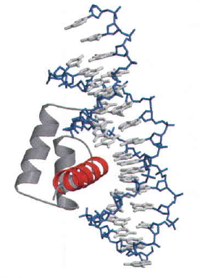
Homeodomain: A type of DNA-binding domain—transcriptional regulator
60 aa long; highly conserved in euk
DNA-binding segment of the domain is related to helix-turn-helix motif

Slide 42
Protein-protein interactions
Two important structural motifs mediating protein-protein interactions are:
Leucine zipper
Basic helix-loop-helix

Slide 43
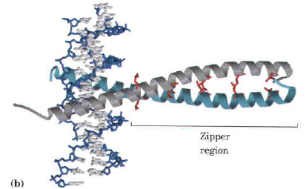
Leucine Zipper
An amphipathic α helix with a series of hydrophobic aa residues concentrated on one side
The alpha helices have Leu residues at every 7th position—forming a straight line along the hydrophobic surface
Regulatory proteins with leucine zippers often have separate DNA-binding domains with high conc of basic aa (Lys or Arg)
Lucine zippers are found in many euk and prok proteins

Slide 45
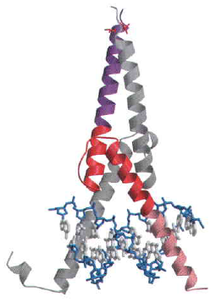
Basic-helix-loop-helix
Motif in Euk regulatory protein
Conserved region of ~50 aa residues important in both DNA binding and protein dimerization
Two short amphipathic α helices linked by a loop of variable length

Slide 46
Additional domains for protein-protein interaction
At least three types of additional domains characterized primarily in euk
Glutamine-rich
Proline-rich
Acidic domains

Slide 47
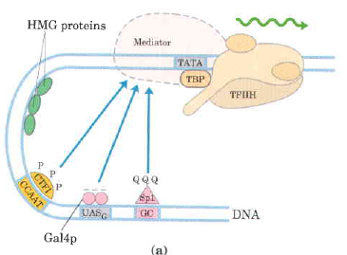
Gal4p—contains a zinc finger-like structure in its DNA-binding domain
Binds to UAS– a palindromic sequence ~ 17 bp
Having acidic activation domain

Slide 48
SP1 – a trancription activator for a large No. of genes in higher euk
DNA binding site – GC box (consensus GGGCGG) near TATA box
Its DNA binding domain contains 3 zinc fingers
Two other domains – function in activation– 25% of their residues are Gln---- thus Glutamine Rich Domains

Slide 49
CTF1 (CCAAT-binding transcription factor 1) – belongs to a family of transcription activators
Bind a sequence CCAAT site (consensus TGGN₆GCCAA)
DNA binding domain contains many basic aa residues
A proline-rich activation domain – Pro more than 20% of the amino acid residues

Slide 50
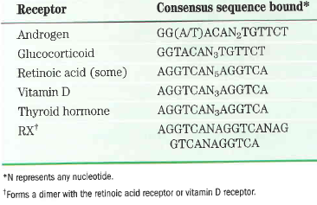
Inter- and intracellular signals
Steroid, retinoid and thyroid hormones—cross plasma membrane by simple diffusion– reach nucleus– bind to specific receptor protein– hormone-receptor complex binds to specific DNA sequence– hormone response elements (HREs)

Slide 51
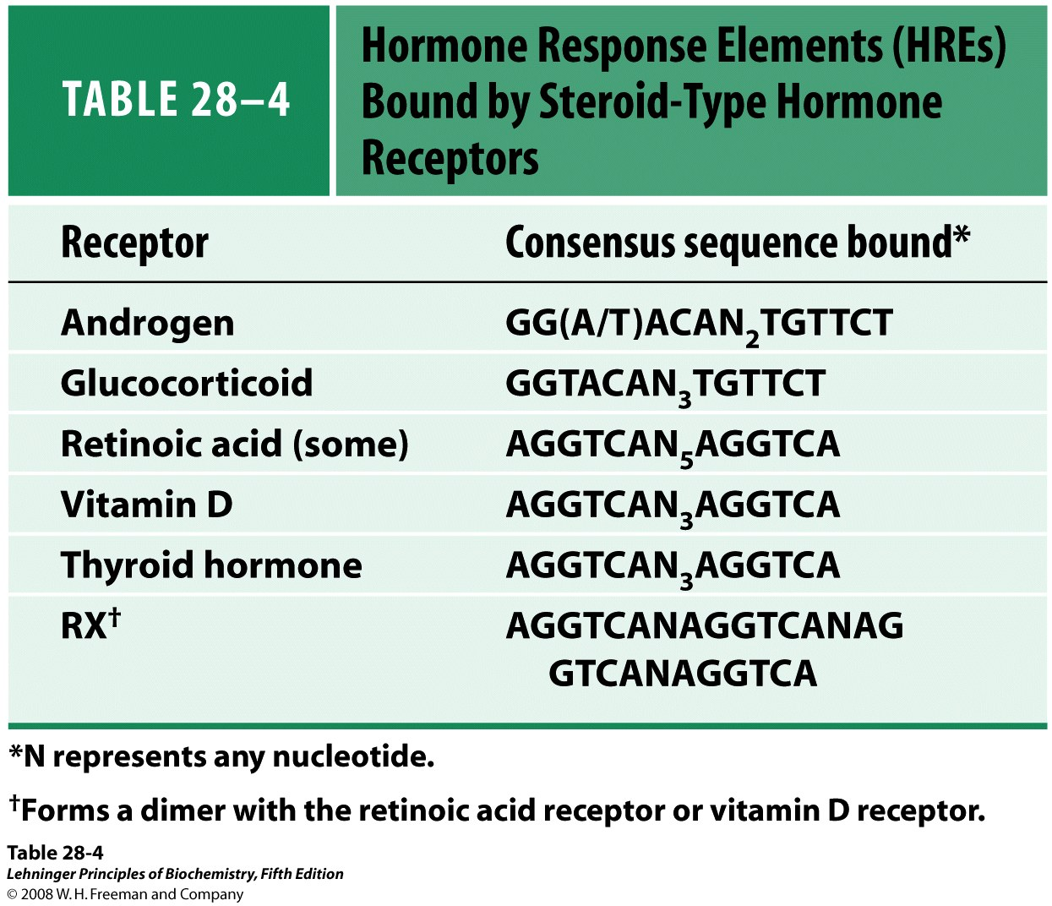
Notes:
TABLE 28-4 Hormone Response Elements (HREs) Bound by Steroid-Type Hormone Receptors

Slide 52
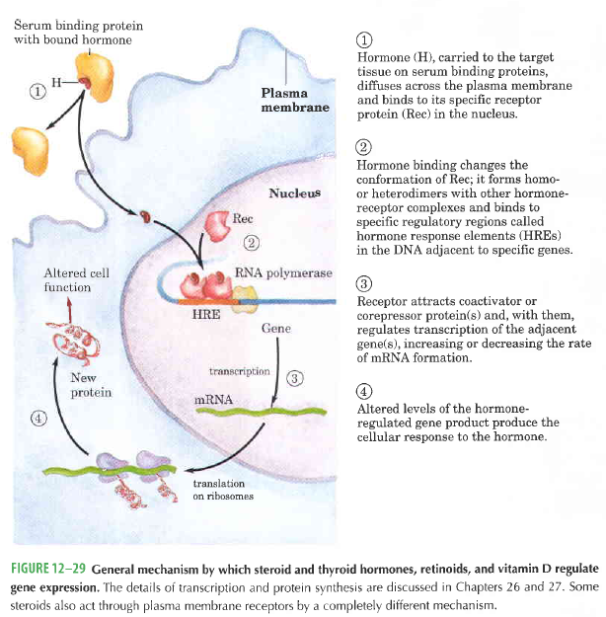

Slide 53
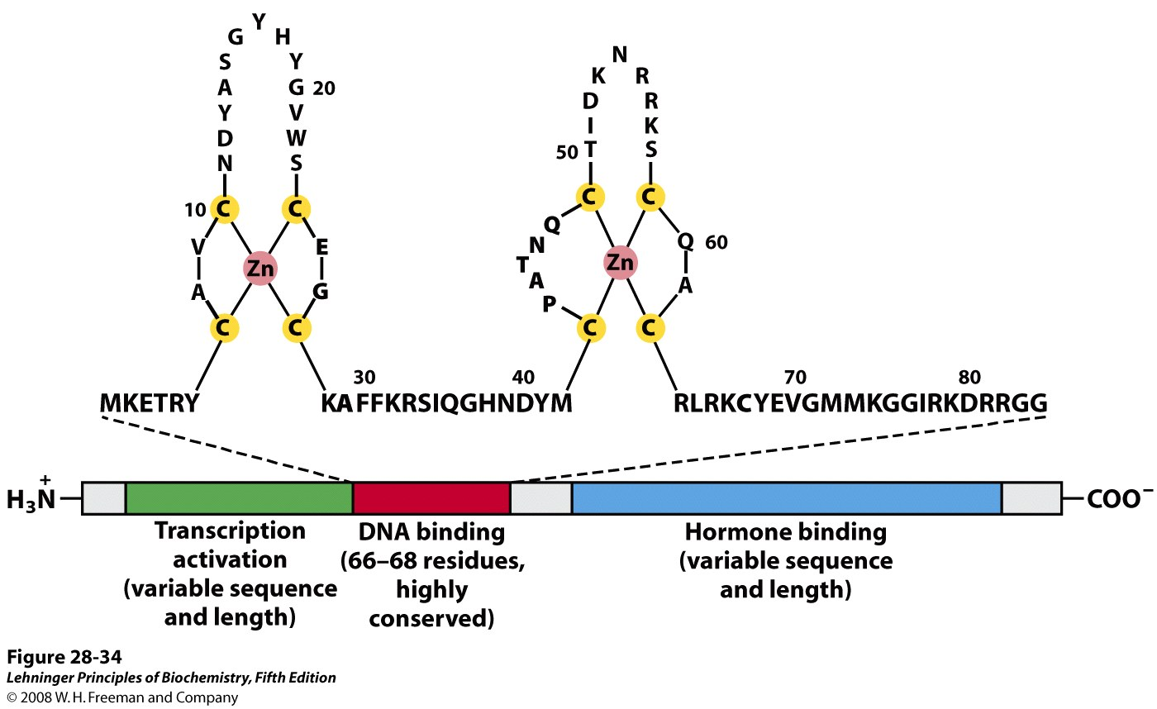
The hormone receptors have a highly conserved DNA binding domain with two zinc fingers
Notes:
FIGURE 28-34 Typical steroid hormone receptors. These receptor proteins have a binding site for the hormone, a DNA-binding domain, and a region that activates transcription of the regulated gene. The highly conserved DNA-binding domain has two zinc fingers. The sequence shown here is that for the estrogen receptor, but the residues in bold type are common to all steroid hormone receptors.

Slide 54
An unusual coactivator: Steroid receptor RNA activator (SRA) a ~700 nucleotide RNA acts as a part of ribonucleoprotein
Ligand binding region of the receptor protein
At carboxy terminus
Quite specific to a particular receptor
Glucocorticoid receptor only 30% similar to estrogen receptor and 17% to thyroid hormone receptor
Size of the ligand-binding region varies
25 aa residues in VitD receptor; 603 aa residues in mineralocorticoid receptors

Slide 55
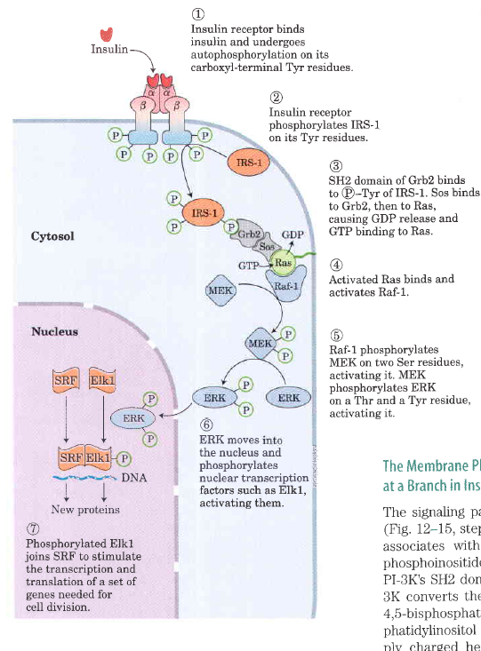

Slide 56
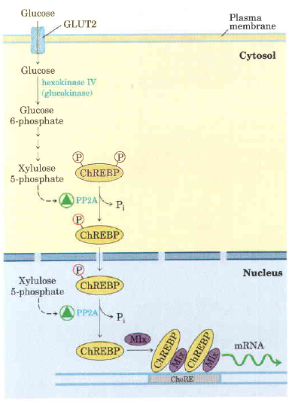
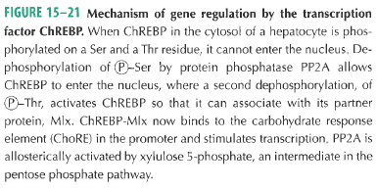
ChREBP (carbohydrate response element binding protein)

Slide 57
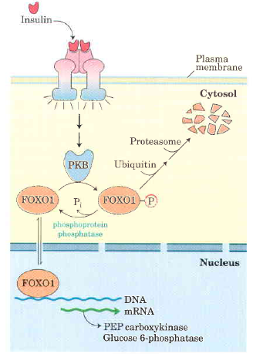
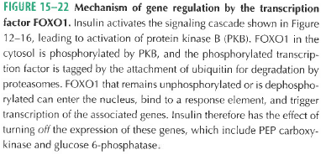

Slide 58
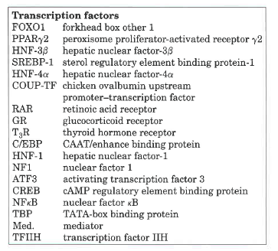
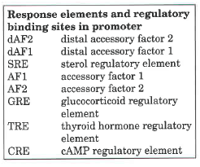
PEP carboxykinase promoter region

Slide 59
Ethylene signaling in Arabidopsis

Slide 60
The JAK-STAT transduction mechanism for the erythropoietin receptor

Slide 61
Transcription factors with significant roles in plant stress tolerance
Transcription factor | Source | Stress | Reference
TaSnRK2.4 | Wheat to Arabidopsis | Drought/salt/freezing | (Mao et al., 2010)
ANAC092 | Arabidopsis | Salt | (Balazadeh et al., 2010)
CaRAV1 | Pepper | Salt/osmotic | (Lee et al., 2010)
GmDREB1 | Soybean to transgenic alfalfa | Salt | (Jin et al., 2010)
Trihelix transcription factors GmGT-2A and GmGT-2B | Soybean to transgenic Arabidopsis | Salt/freezing/drought | (Xie et al., 2009)
R2R3 MYB | Arabidopsis | Salt/drought | (Ding et al., 2009)
NAC transcription factors NAM, ATAF, CUC | Rice | Salt/low temperature/drought | (Fang et al., 2008)
Basic-leucine zipper (bZIP) factors GmbZIP132 | Soybean | Salt/drought | (Liao et al., 2008)
WRKY-type factors GmWRKY13 GmWRKY21 GmWRKY54 | Soybean to transgenic Arabidopsis | Salt/mannitol Cold Salt/drought | (Zhou et al., 2008)
SNAC2 (NAC type) | Rice | Salt/drought/cold/wounding/ABA | (Hu et al., 2008)
Homeodomain-leucine-zipper (HD-Zip | Cotton | Salt | (Ni et al., 2008)
AtMYB44 | Arabidopsis | salt/dehydration/low temperature | (Jung et al., 2008)
MtZpt2-1, MtZpt2-2 | Barrel Clover (Medicago truncatula) | Salt | (de Lorenzo et al., 2007)
OsNAC6 (NAC type) | Rice | Salt/dehydration | (Nakashima et al., 2007)
Zat12 (zinc finger) | Arabidopsis | Salt/cold/oxidative/osmotic/high light/heat | (Davletova et al., 2005)
40 transcription factor genes | Arabidopsis | Salt/drought/cold | (Seki et al., 2002b)

Slide 62
CREB (cAMP response binding protein)

Slide 63
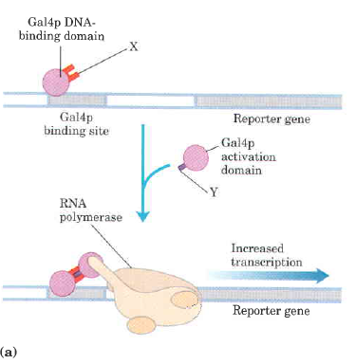
Yeast-two hybrid

Slide 65
Translational control of genes
1. Ttanslational initiation factors are subject to phosphorylation by protein kinases. The phosphorylated forms are often less active and cause a general depression of translation in the cell.
2. Some proteins bind directly to mRNA and act as translational repressors, many of them binding at specific sites in the 3’ untranslated region (3’UTR). So positioned these proteins interact with other translation initiation factors bound to the mRNA or with the 40S ribosomal subunit toprevent translation initiation

Slide 66
Translational regulation of eukaryotic mRNA
Notes:
FIGURE 28-35 Translational regulation of eukaryotic mRNA. One of the most important mechanisms for translational regulation in eukaryotes involves the binding of translational repressors (RNA-binding proteins) to specific sites in the 3′ untranslated region (3′UTR) of the mRNA. These proteins interact with eukaryotic initiation factors or with the ribosome (see Figure 27-27) to prevent or slow translation.

Slide 67
3. Binding proteins, present in eukaryotes from yeast to mammals, disrupt the interaction between elF4E and eIF4G (see Fig. 27-27). The mammalian versions are known as 4E-BPs (eIF4E binding proteins). When cell growth is slow, these proteins
limit translation by binding to the site on eIF4E that normally interacts with eIF4G. When cell growth is slow or increases in response to growth factors or other stimuli, the binding proteins are inactivated by protein kinase-dependent phosphorylation.
4. RNA-mediated regulation of gene expression often occurs at the level of Translational repression

Slide 71
Catabolite repression
Schmoll M and Kubicek CP. 2003. Regulation of Trichoderma cellulase formation: Lessons in molecular biology from an industrial fungus.
Acta Microbiol Immuhnol Hung. 50(2-3): pp: 125-45

Slide 72
Cellulases gene expression in fungi
Hypocrea jacorina (Trichoderma reesei)……most studied fungus for cellulases production
Glucose represses the cellulases production
Sophorose (β-1,2-glycosidic bond) is natural inducer of cellulases, formed by transglycosylation of cellobiose

Slide 73
cbh1 promoter
Cre1 is repressor protein; it is similar to CreA of Aspergillus nidulans and Mig1 of S. cerevisiae
Cre1 is a phosphoprotein; glucose leads to phosphorylation of Cre1 (at Ser₂₄₁) which binds to the promoter region
Two Cre1 binding sites are there on cbh1 promoter; one at -700 and other at -1000

Slide 74
Two activators of Cbh1
Ace1…Activator of cellulase gene expression; a DNA binding protein (3 zinc finger motifs of Cys(2)-His(2) type
At least 8 binding sites of Ace1 are present in cbh1 promoter…..recognizes AGGCAAA and some AGGCA sites
Ace2…Also a DNA binding protein of Zn finger class
Ace2 binds to GGTAATAAA site at -779

Slide 75
cbh2 regulation
CAE (cbh2-activating element) is a nucleotide sequence 5’ATTGGGTAATA that binds to a protein complex
At least one copy of CCAAT in template strand or GTAATA on coding strand is needed adjacent to CAE
Different proteins bind to CAE
CCAAT motif binds to HAP2/3/5 (Heme activated protein)
HAP4 binds directly to HAP2/3/5 trimer

Slide 76
xyn1 and xyn2 promoters for xylanase gene expression
XlnR is transcriptional of A. niger xylanolytic system; it is Zn binnulear (Zn₂Cys₆) cluster protein
Controls transcription of many xylan degrading gene
Also controls eglA and eglB genes

Slide 77
Mach, RL, Zeilingers S. 2003. Regulation of gene expression in industrial fungi: Trichoderma. Appl Microbiol Biotechnol. 60(5): 515-22

Slide 83
Real Time PCR (Quantitative PCR; Kinetic PCR

Slide 84
PCR product depends on template
For twice as much initial template (2T), there is twice as much PCR product in exponential phase. For 4xT, there is 4x PCR product, etc.

